Slide 1
Forest Fire Prediction
By:
121910311022-P.Saketh Naidu
121910311019-Lahari

Slide 2
Problem Statement
To prevent a significant environmental problem that creates ecological destruction of natural resources that disrupts the stability of the ecosystem. Forest fires endanger not only the forest`s wealth but also the entire ecosystem`s animals and vegetation, causing significant disruption of a region`s biodiversity, ecology, and environment.

Slide 3
Objectives
To create a fire prediction system that uses minimal data to predict fire occurrence.
To reduce the impact of forest fires in future
The proposed system would help to minimize the forest fire by predicting fire occurrence by calculating the temperature, oxygen, and humidity of an area.

Slide 4
Methods Used
Logistic regression
Logistic regression is one of the most popular Machine Learning algorithms under the Supervised Learning technique. It is used for predicting the categorical dependent variable using a given set of independent variables.
Logistic regression predicts the output of a categorical dependent variable. Therefore the outcome must be an absolute or discrete value. It can be either Yes or No, 0 or 1, true or False, etc., but instead of giving the exact weight as 0 and 1, it provides the probabilistic values between 0 and 1.
Logistic Regression is much similar to Linear Regression except for how they are used. Linear Regression is used for solving Regression problems, whereas Logistic regression is used for solving the classification problems.
In Logistic regression, instead of fitting a regression line, we include an "S" shaped logistic function, which predicts two maximum values (0 or 1)

Slide 5
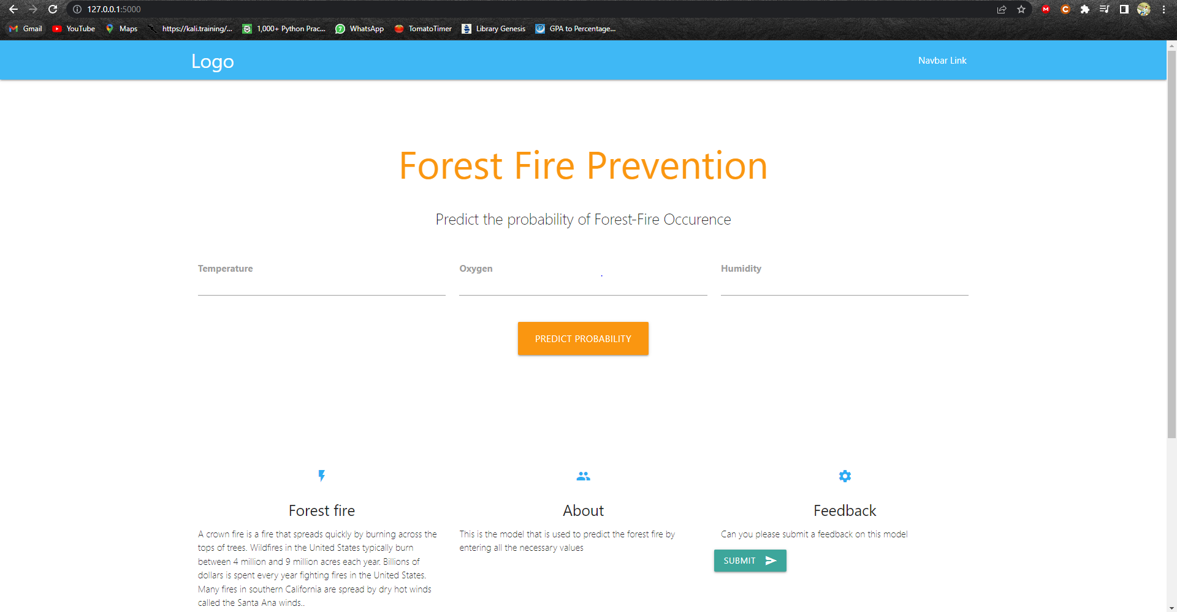
Front-End

Slide 6

Data Base

Slide 7
Conclusion
In this model, we will be predicting whether the forest is in danger or not by entering the three values Like oxygen, temperature, and humidity

Slide 8
Thank You

